Slide 1
ShopSmart
Smarter shopping made simple

Slide 2
Table of contents
Introduction
01
04
Product demo
Problem & solution
02
05
Team & timeline
Market opportunity
03
06
Financial & metrics

Slide 3

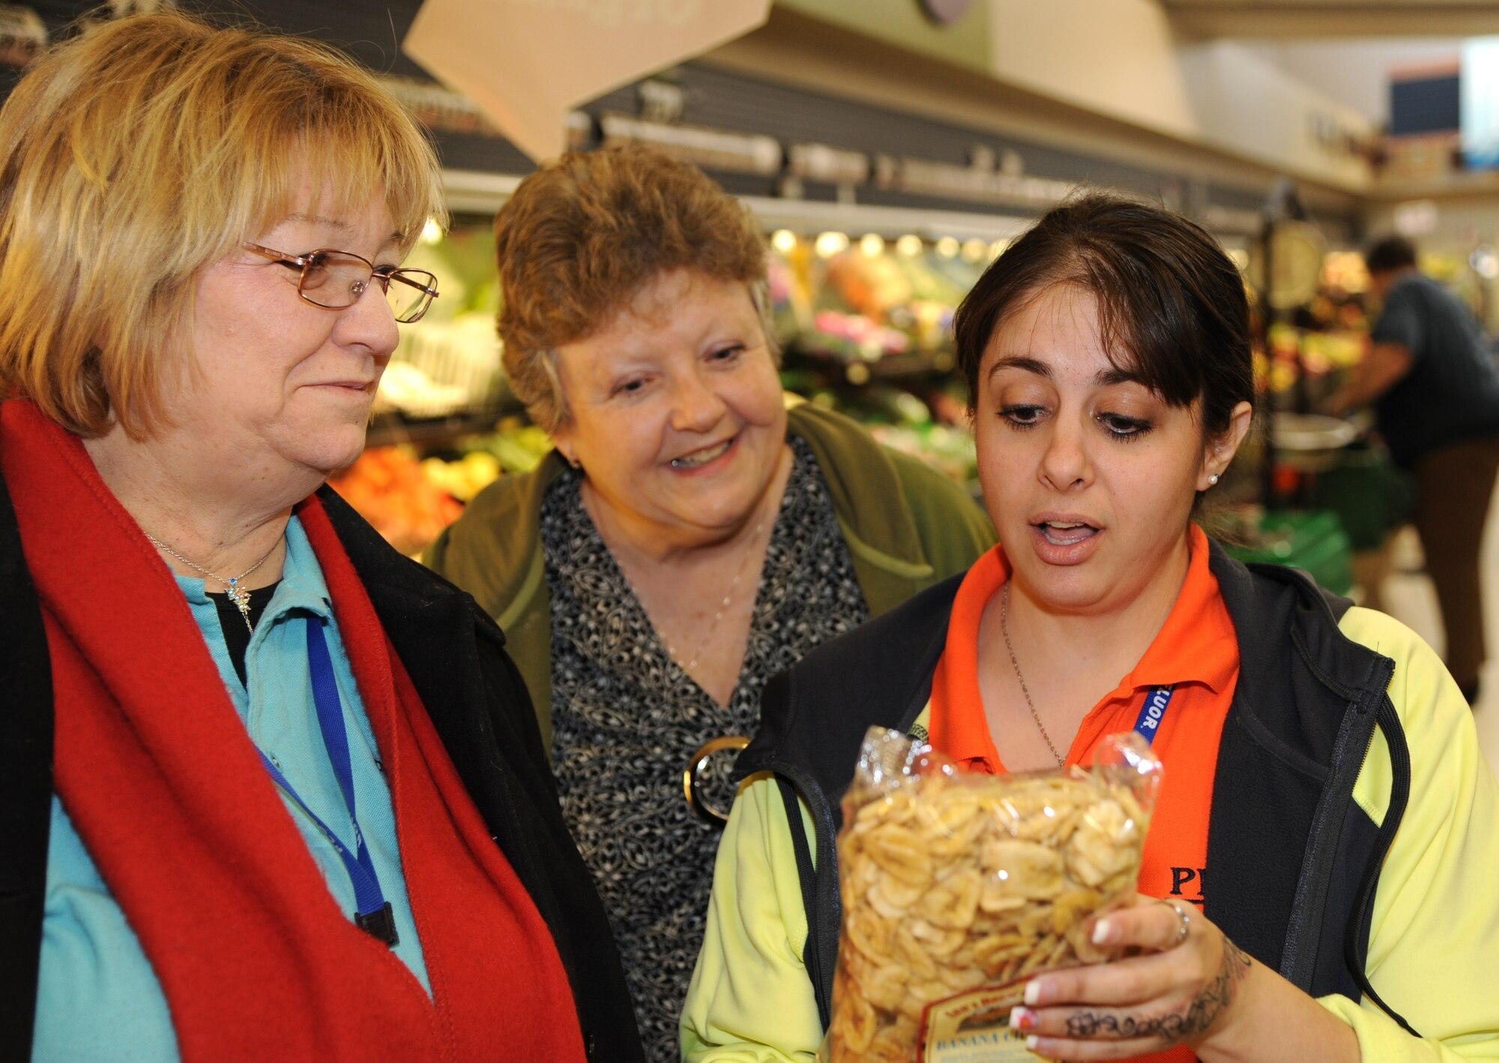
01
Introduction
Emily
-Busy Professional
-No time to check expiration dates while shopping
-Ends up overspending
Sarah
-Health-conscious mom
-Carefully chooses products, worried about hidden ingredients
-Time-taking leading to anxiety & confusion

Slide 4
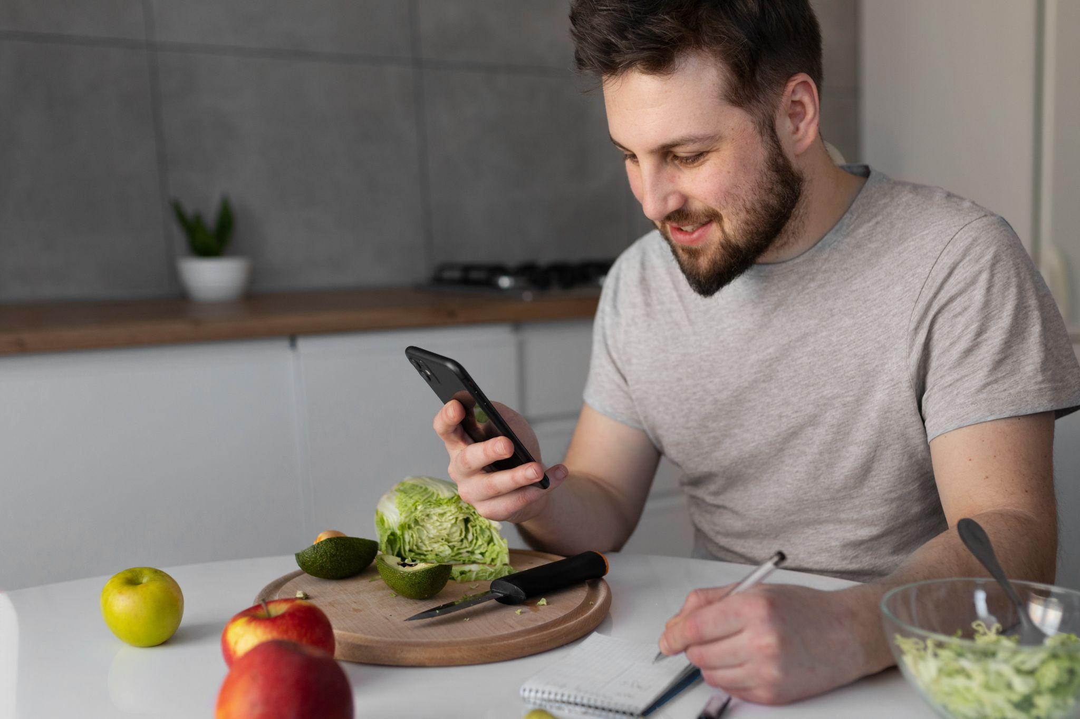
Why is a shopping assistant needed?
A pitch deck is a short presentation that entrepreneurs use to describe their business and present it to potential investors. It usually consists of about 10 slides that provide the following:
An overview of the company's mission, product and service
Market opportunity
Team, financials, etc.
The goal is to garner enough interest from investors so that they are motivated to invest in the business

Slide 5
Problem Solved by ShopSmart
Consumer overconsumption
Expired food
Lack of awareness
Price comparisons

Slide 6
Other Shopping Assistant Apps
What is Instacart?
Key Features of Instacart
Mobile Accessibility and User Accounts
Product Variety
Local Store Integration
Shopping List

Slide 7
Other Shopping Assistant Apps
What is Flipp?
Key Features of Flipp
Deal Comparison
Target Audience
Notification Customization
Weekly Circulars

Slide 8
Why ShopSmart Stands out?
Target Audience and Personalization
Real-time price comparisons
Exclusive Offers and Discounts
Nutritional Information
All in one solution

Slide 9
Main ideas of a pitch deck
Presentation
Investors
Value
A great presentation should be concise, clear and easy to understand. Visual elements such as charts and images can help to make the presentation more engaging
When it comes to picking investors for a pitch deck, it's important to research potential investors and understand their preferences, goals and interests
The value of a product is determined by how much customers are willing to pay for it. It's a combination of factors, with how well it meets customer needs

Slide 10
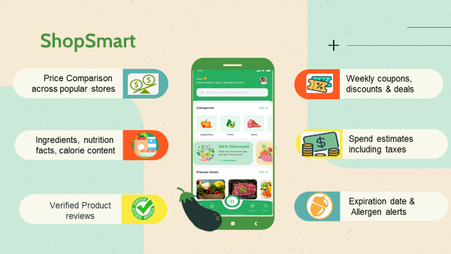

Slide 11

ShopSmart
Visuals
Features
Showcase your product’s design
What makes you product unique?
Price
Users
Cost/price with investors
Speak about the target audience
Availability
Updates
When is it expected to be ready?
Do you plan on updating it?

Slide 12
ShopSmart Business Model
Subscription Model
Premium Features for Businesses
Commission from Retailers
Partnerships W/ Grocery Chains
Crowdsourced Data
Localized Deals & Offers
In-App Advertising

Slide 13
Thanks!
Do you have any questions?
youremail@freepik.com
+34 654 321 432
yourwebsite.com
Please keep this slide for attribution

